Slide 1
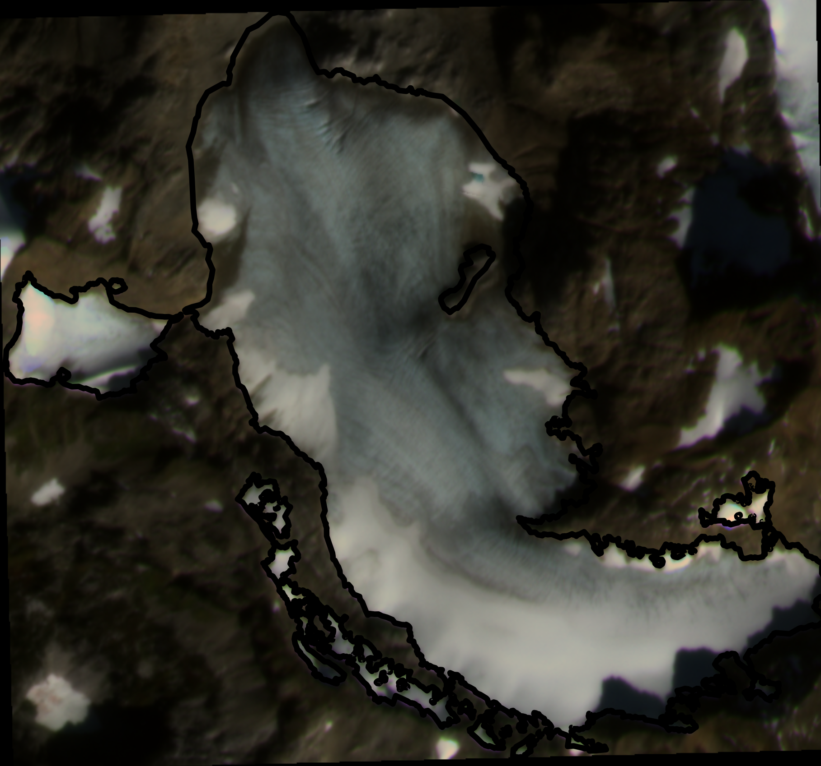
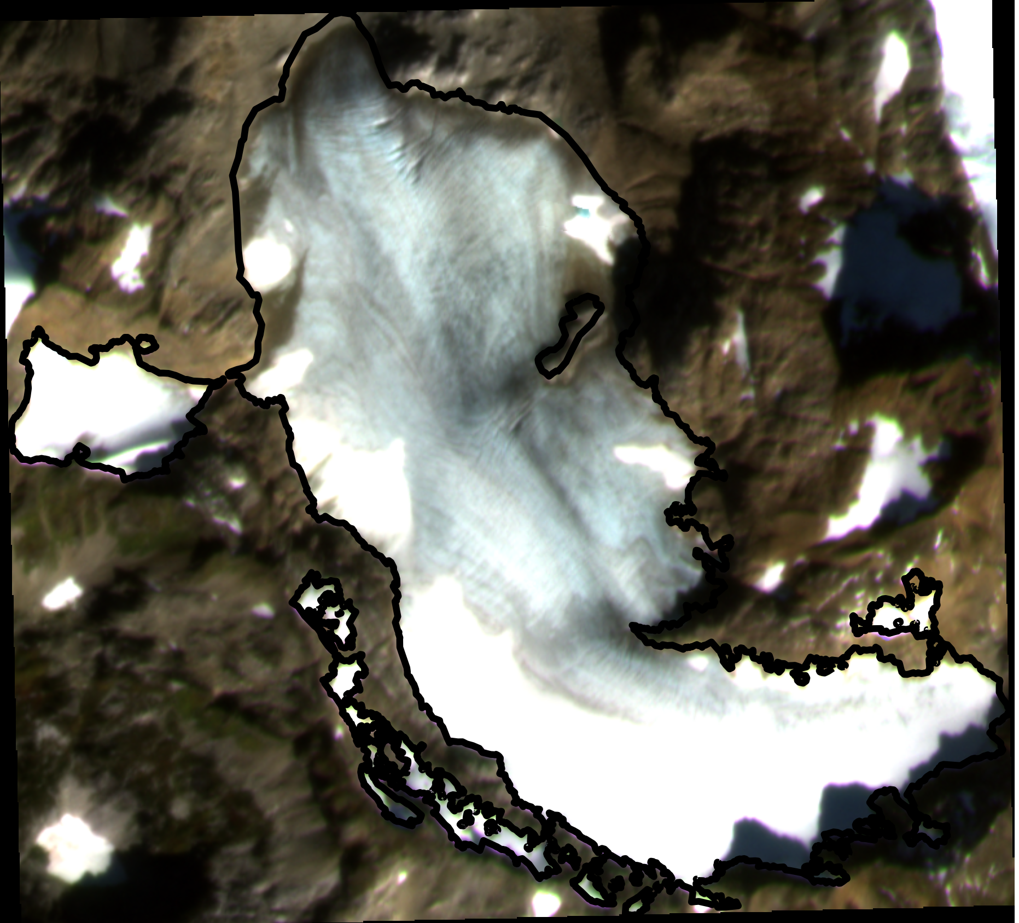
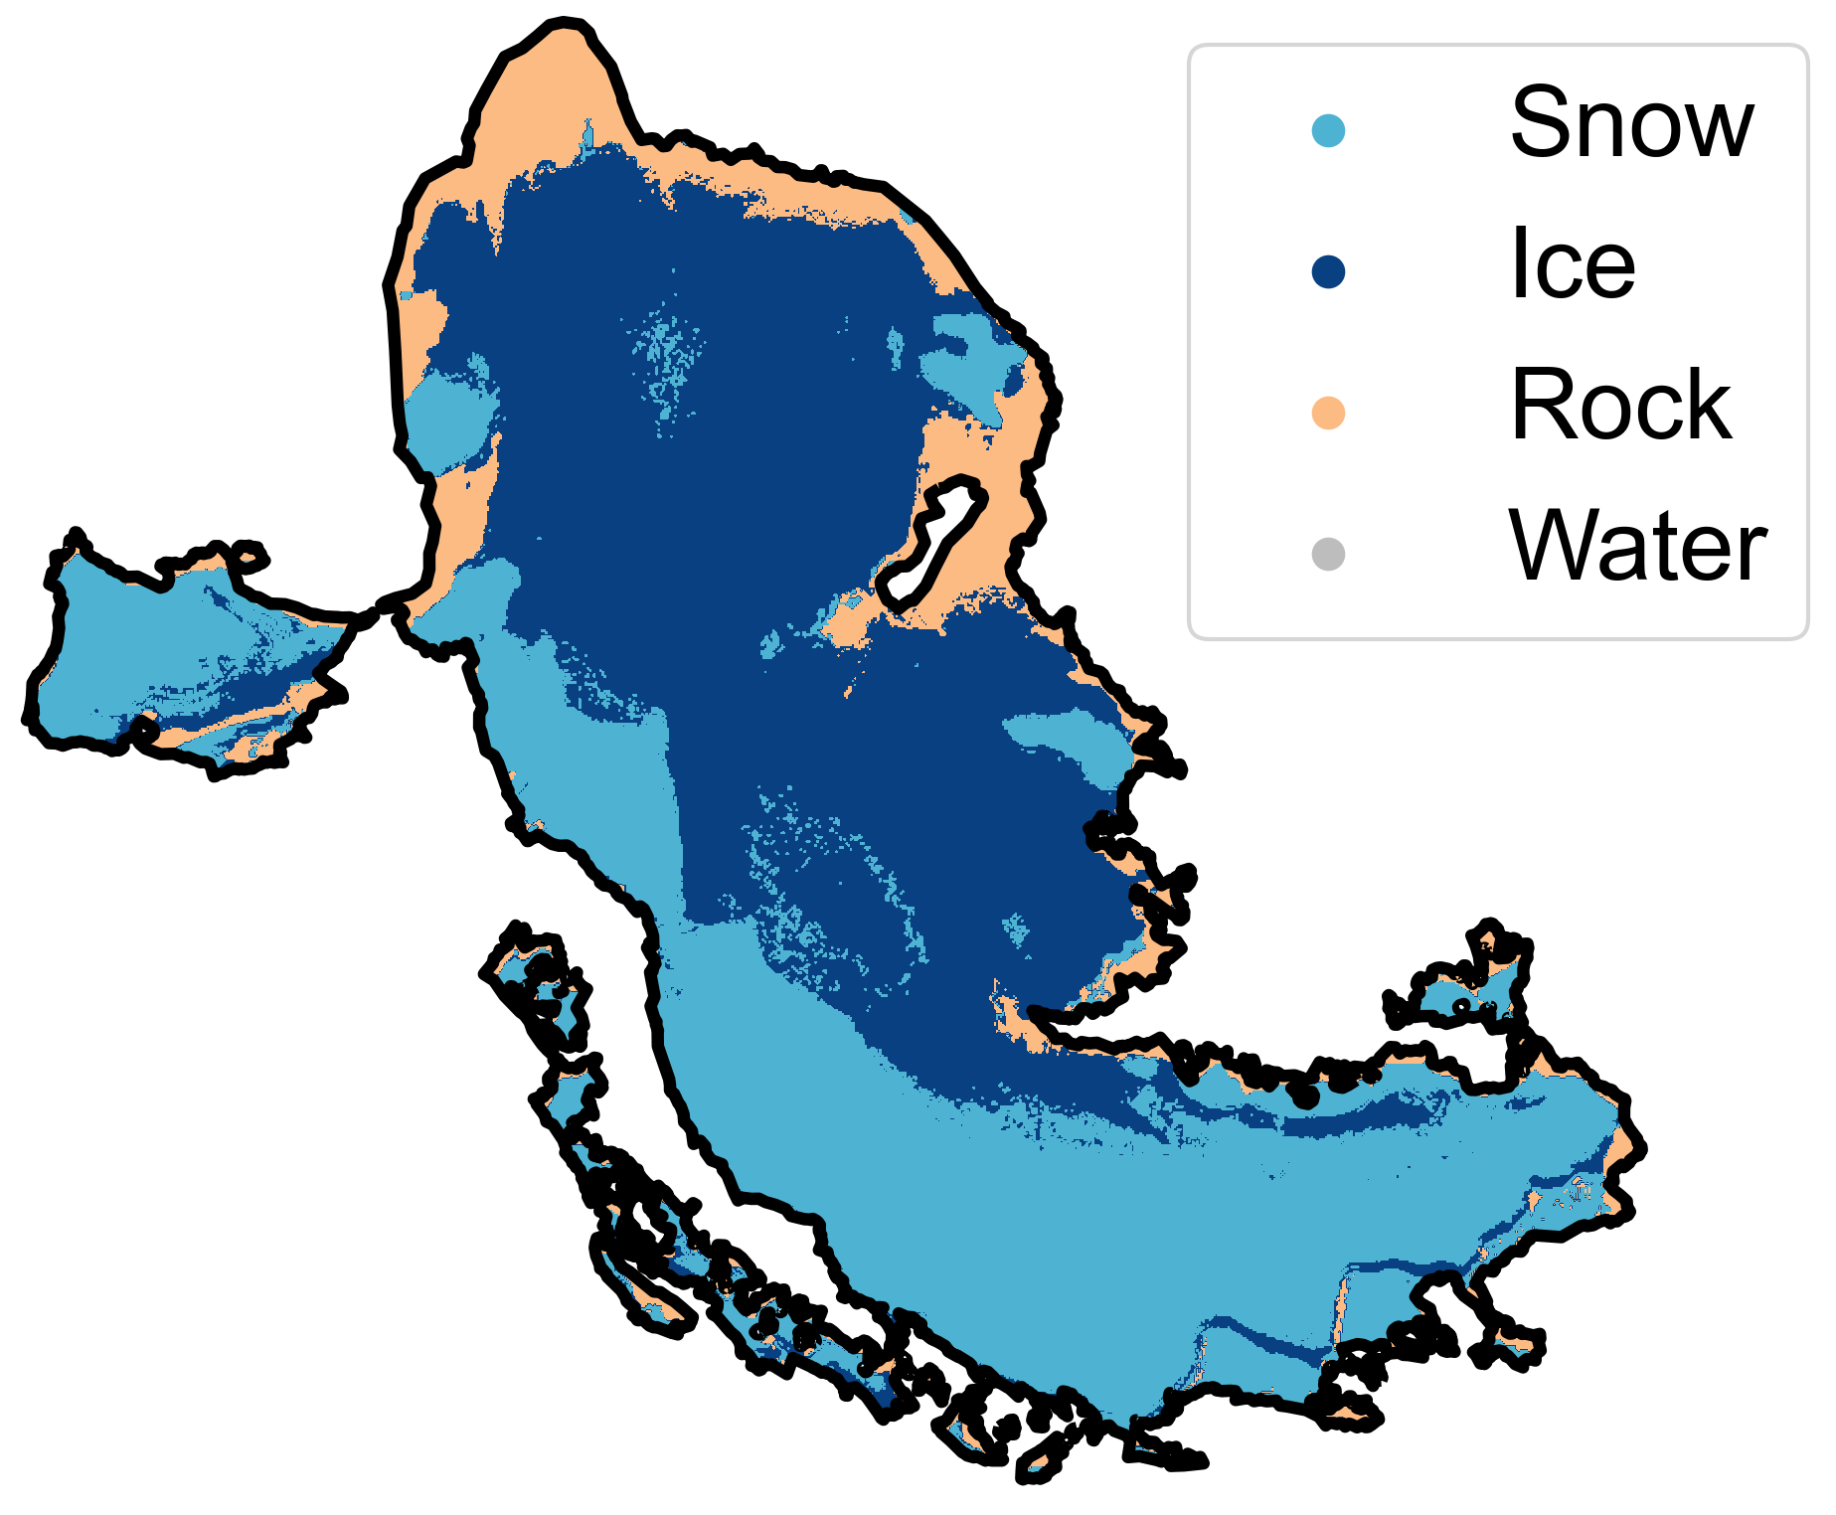
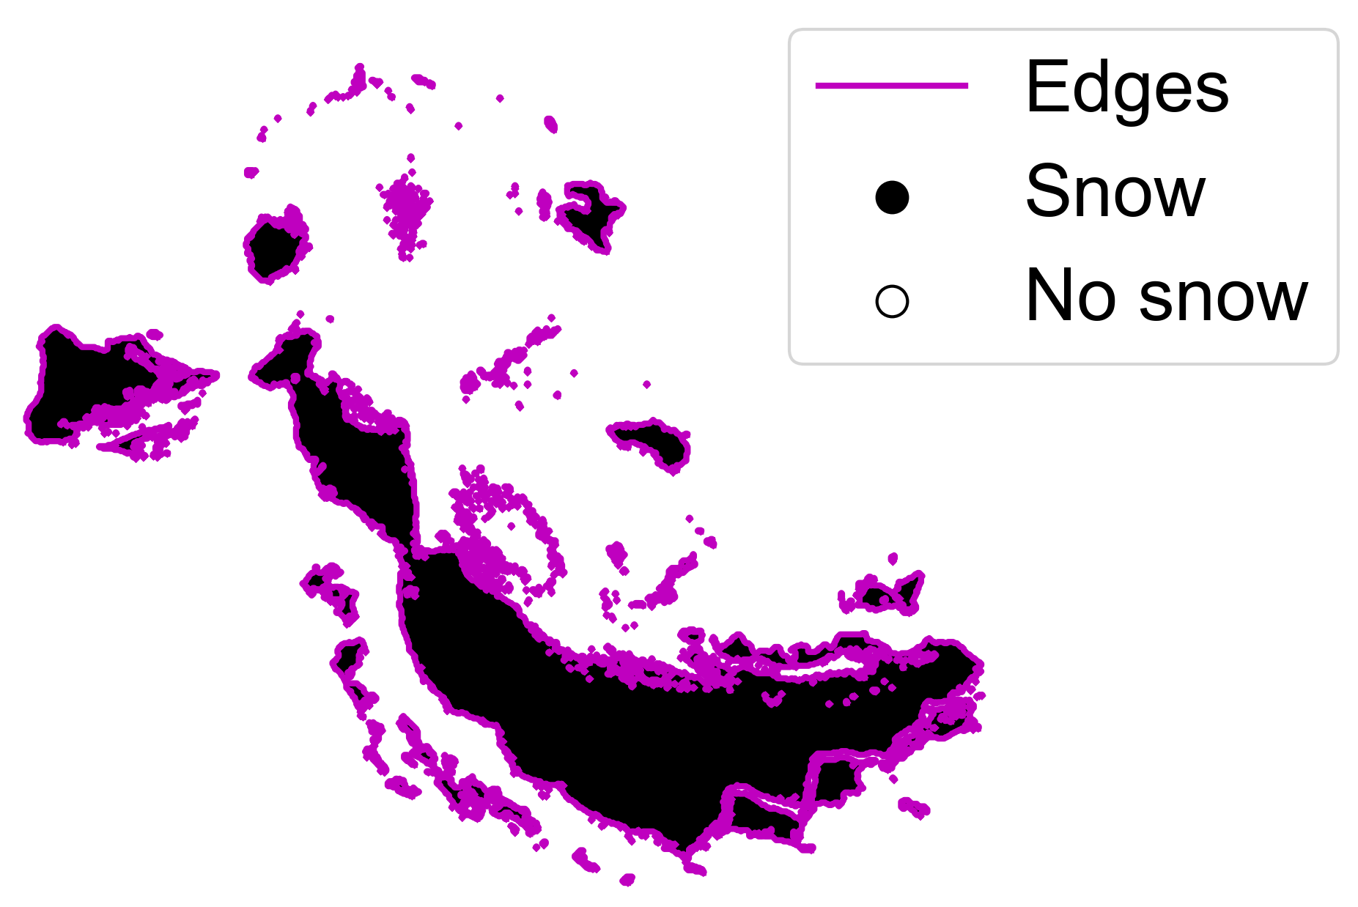
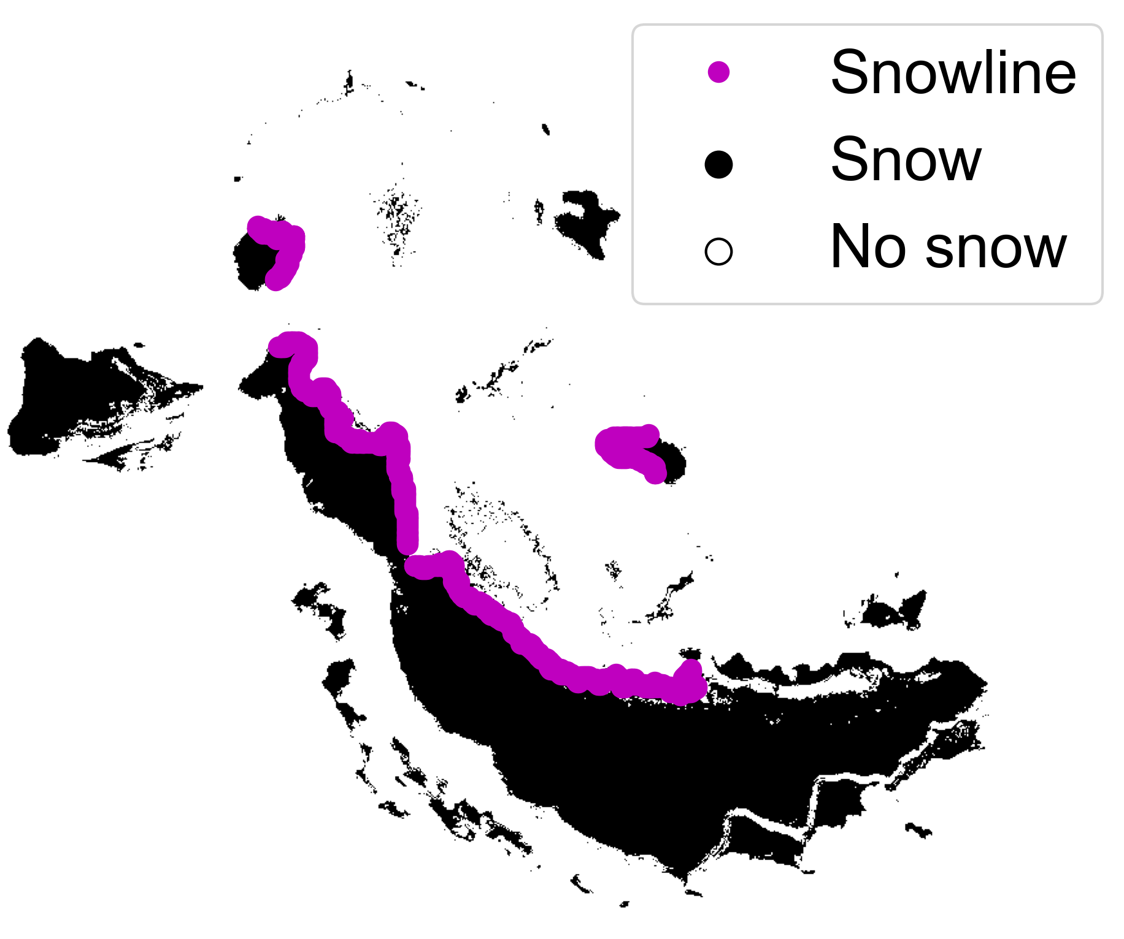
1. PRE-PROCESS
Landsat 8/9 OLI
2. CLASSIFY
PlanetScope 4-band
Sentinel-2 MSI
Filter clouds and cloud shadows
Adjust radiometry
3. IDENTIFY SNOWLINES
Mosaic images captured same day
Landsat classifier
Sentinel
classifier
PlanetScope classifier
Area of Interest
Classify image collections
4. FILTER SNOWLINES
Create binary snow image
Identify edges
Filter edges, identify snowline(s)
Digital Elevation Model
Extract snow-covered elevations
Stack median snowline elevations by month
Filter outlier points using the monthly median and interquartile range

